Slide 1


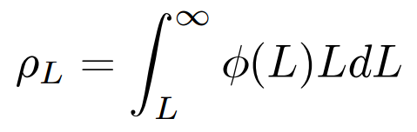


Calculating Higher Limit of Redshift
& Thereby Estimating Epoch of Reionization
Kennicutt (1998)
The z at which Reionization begins
is found from the luminosity density
is found from an analytical model

Slide 2
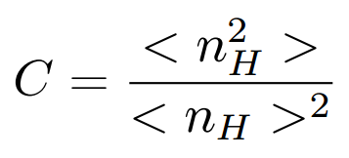
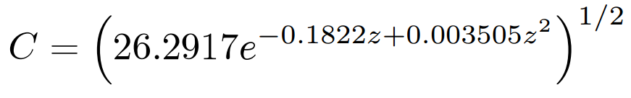
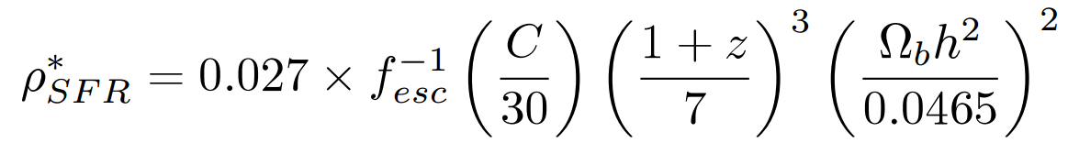
Critical Star Formation Rate Density
Recombination rate is proportional to clumping factor
Clumping Factor
Model
(Illev et al. 2007)
Critical Star Formation Rate Density relation
(Bagala et al. 2009)

Slide 3
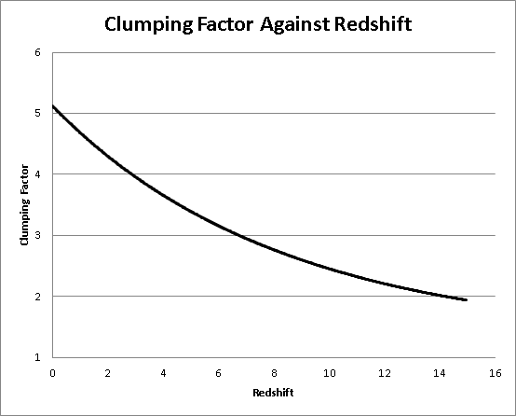

Slide 4
Star Formation Rate Density
Area under the schechter function is infinite unless L is specified
We need a lower luminosity limit
Lower Limit comes from lower mass → Jeans Mass

Slide 5
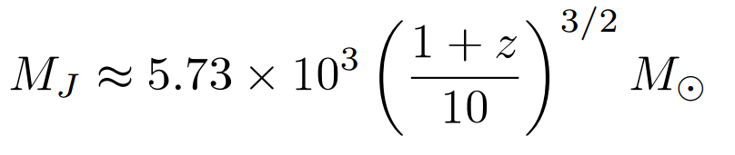
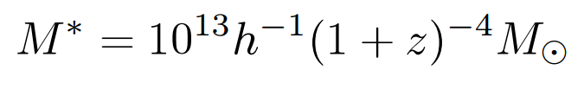
Minimum Luminosity
At z=106, MJ is approximately 1.1x10⁵
Using a Mass-Luminosity ratio of order unity
L≈1.1x10⁵ Solar Luminosity
Corresponds to Absolute Magnitude of -7.5

Slide 6
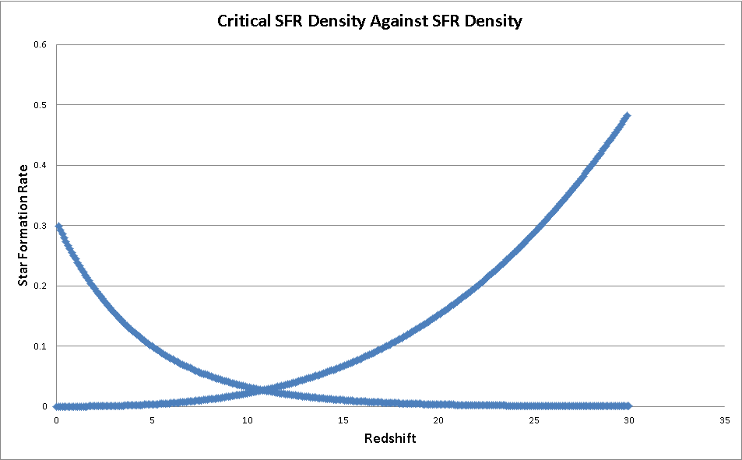
(Solar Masses per year per Megaparsec cubed)
Critical SFR Density
SFR Density

